Slide 1
Tensor Completion for estimating missing values in visual data

Slide 2
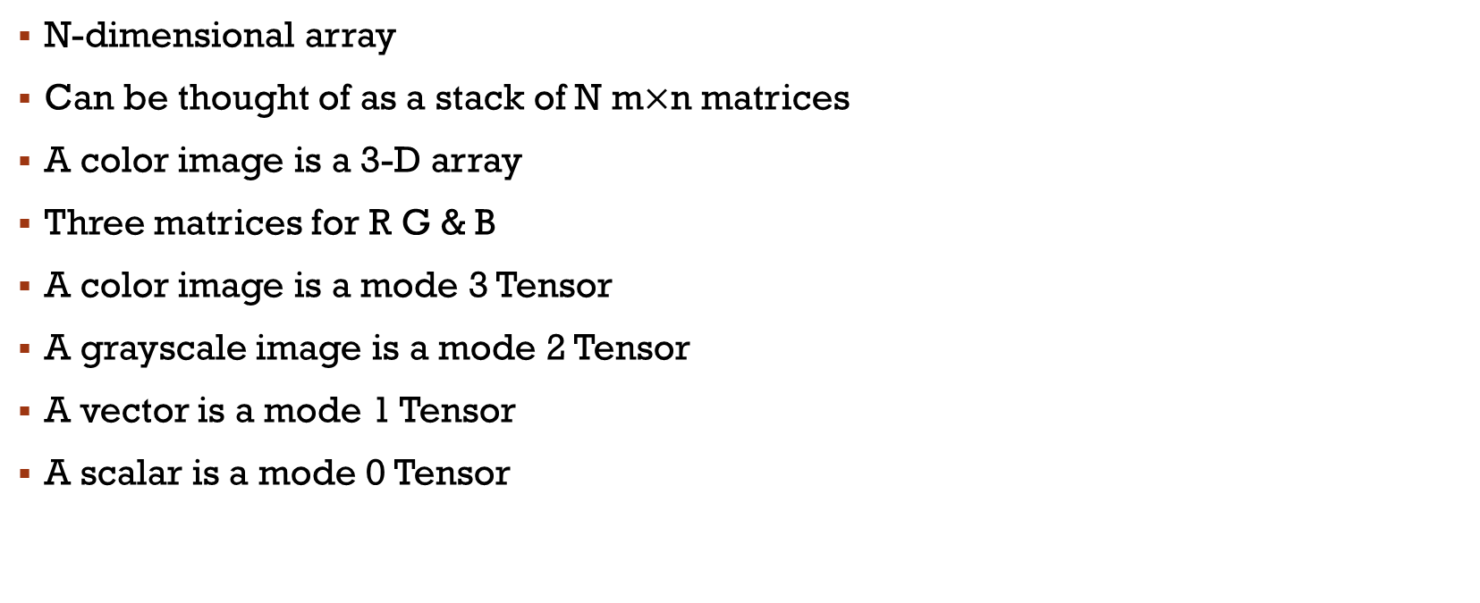
What is a tensor?
N-dimensional array
Can be thought of as a stack of N m$×$n matrices
A color image is a 3-D array
Three matrices for R G & B
A color image is a mode 3 Tensor
A grayscale image is a mode 2 Tensor
A vector is a mode 1 Tensor
A scalar is a mode 0 Tensor

Slide 3
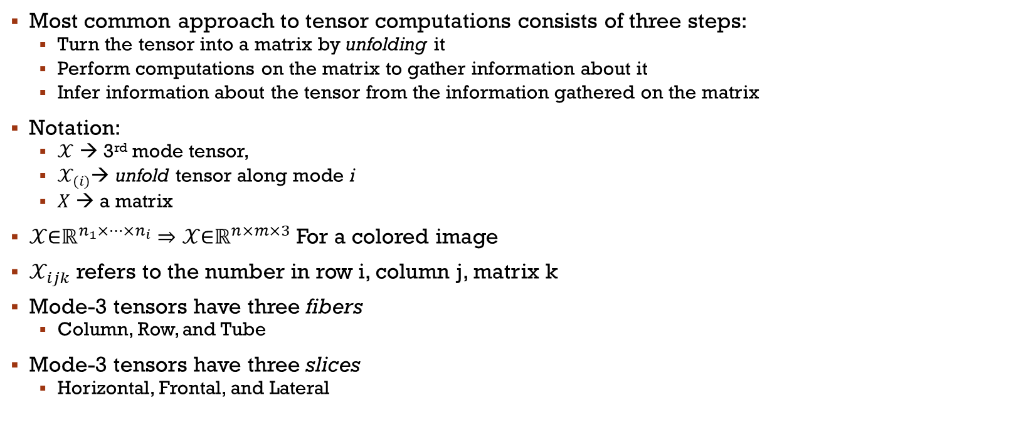
Tensor Decomposition
Most common approach to tensor computations consists of three steps:
Turn the tensor into a matrix by unfolding it
Perform computations on the matrix to gather information about it
Infer information about the tensor from the information gathered on the matrix
Notation:
$𝒳$ → 3rd mode tensor,
$𝒳_{(i)}$→ unfold tensor along mode i
$X$ → a matrix
$𝒳\text{∈}ℝ^{n_{1}×…×n_{i}}⇒$ $𝒳\text{∈}ℝ^{n×m×3}$ For a colored image
$𝒳_{ijk}$ refers to the number in row i, column j, matrix k
Mode-3 tensors have three fibers
Column, Row, and Tube
Mode-3 tensors have three slices
Horizontal, Frontal, and Lateral

Slide 4
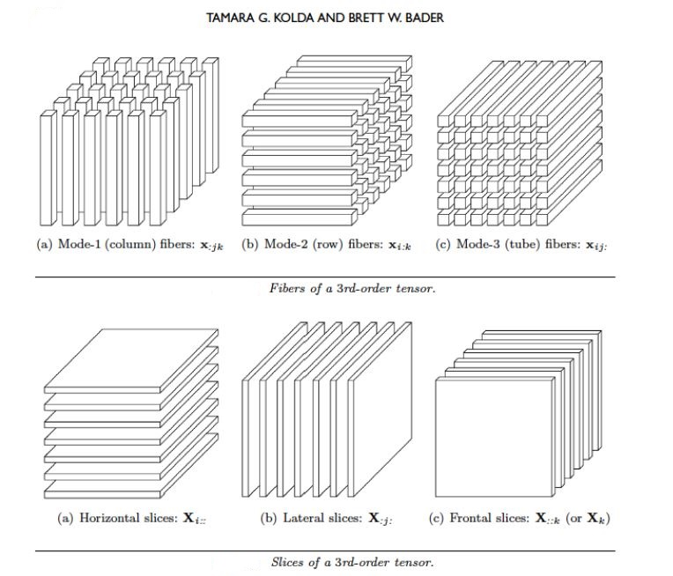
Tensor Decomposition

Slide 5
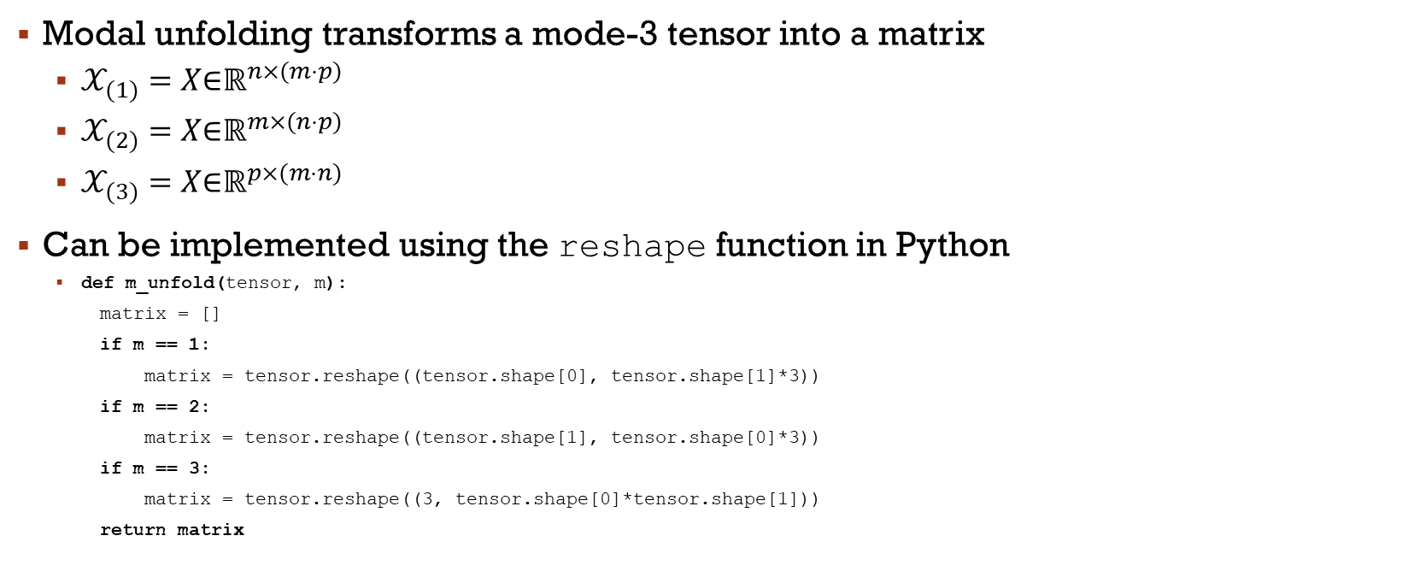
Tensor Decomposition
Modal unfolding transforms a mode-3 tensor into a matrix
$𝒳_{(1)}=X\text{∈}ℝ^{n×(m⋅p)}$
$𝒳_{(2)}=X\text{∈}ℝ^{m×(n⋅p)}$
$𝒳_{(3)}=X\text{∈}ℝ^{p×(m⋅n)}$
Can be implemented using the reshape function in Python
def m_unfold(tensor, m):
matrix = []
if m == 1:
matrix = tensor.reshape((tensor.shape[0], tensor.shape[1]*3))
if m == 2:
matrix = tensor.reshape((tensor.shape[1], tensor.shape[0]*3))
if m == 3:
matrix = tensor.reshape((3, tensor.shape[0]*tensor.shape[1]))
return matrix

Slide 6
Tensor Decomposition
Use the fold function to fold a matrix back into a tensor
def fold(matrix, original_shape):
tensor = matrix.reshape(original_shape)
return tensor
Can also use the TensorLy library’s fold & unfold functions
Three tensor completion algorithms discussed in this paper:
SiLRTC – Simple Low Rank Tensor Completion
FaLRTC – Fast Low Rank Tensor Completion
HaLRTC – High Accuracy Low Rank Tensor Completion
All three algorithms use the fold and unfold operations as well as the shrinkage and truncate operators as their basic underlying machinery

Slide 7
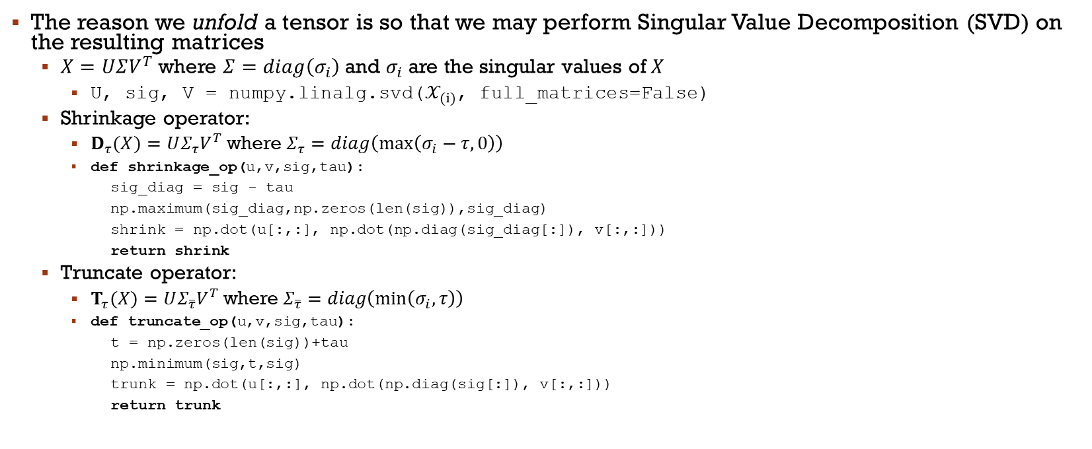
Tensor Decomposition
The reason we unfold a tensor is so that we may perform Singular Value Decomposition (SVD) on the resulting matrices
$X=UΣV^{T}$ where $Σ=diag\left(σ_{i}\right)$ and $σ_{i}$ are the singular values of $X$
U, sig, V = numpy.linalg.svd($𝒳_{(i)}$, full_matrices=False)
Shrinkage operator:
$D_{τ}(X)=UΣ_{τ}V^{T}$ where $Σ_{τ}=diag\left(\max\left(σ_{i}−τ,0\right)\right)$
def shrinkage_op(u,v,sig,tau):
sig_diag = sig - tau
np.maximum(sig_diag,np.zeros(len(sig)),sig_diag)
shrink = np.dot(u[:,:], np.dot(np.diag(sig_diag[:]), v[:,:]))
return shrink
Truncate operator:
$T_{τ}(X)=UΣ_{\overline{τ}}V^{T}$ where $Σ_{\overline{τ}}=diag\left(\min\left(σ_{i},τ\right)\right)$
def truncate_op(u,v,sig,tau):
t = np.zeros(len(sig))+tau
np.minimum(sig,t,sig)
trunk = np.dot(u[:,:], np.dot(np.diag(sig[:]), v[:,:]))
return trunk

Slide 8
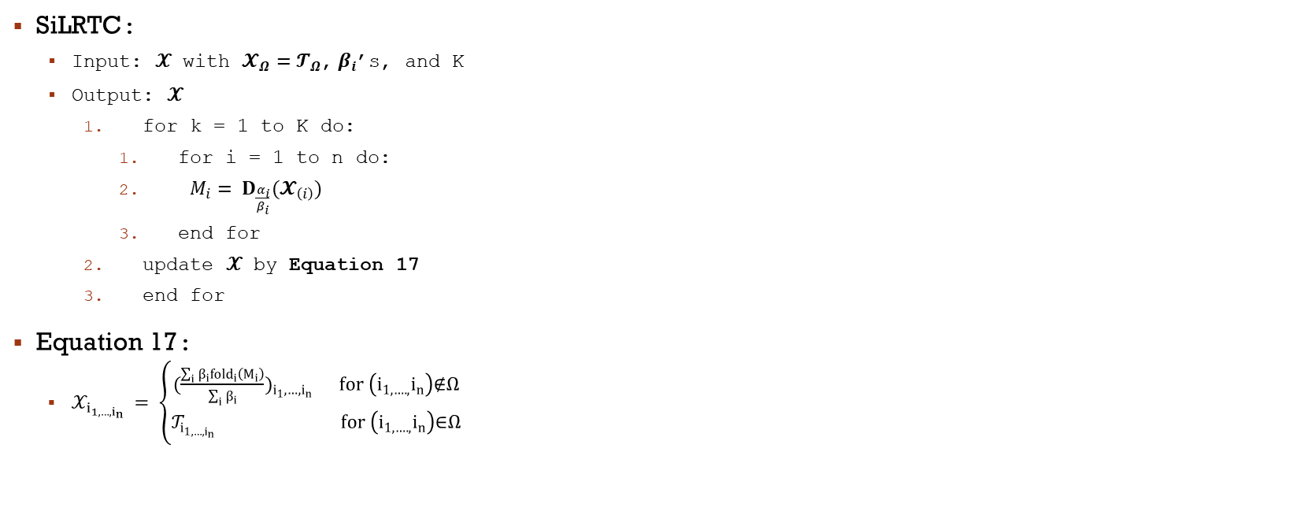
SiLRTC Algorithm
SiLRTC:
Input: 𝒳 with $𝓧_{Ω}=𝓣_{Ω}$,$β_{i}$’s, and K
Output: 𝒳
for k = 1 to K do:
for i = 1 to n do:
$M_{i}= D_{\frac{α_{i}}{β_{i}}}(𝓧_{\left(i\right)})$
end for
update 𝒳 by Equation 17
end for
Equation 17:
$𝒳_{i_{1,…,i_{n}} }= \left\{\begin{aligned}({\frac{\sum_{i}{β_{i}}{fold}_{i}\left(M_{i}\right)}{\sum_{i}{β_{i}}})}_{i_{1},…,i_{n}} for \left(i_{1,….,}i_{n}\right)\text{∉}Ω \\ 𝒯_{i_{1,…,i_{n}} } for \left(i_{1,….,}i_{n}\right)\text{∈}Ω\end{aligned}\right.$

Slide 9
Silrtc algorithm
Implementation:
def SiLRTC(X, b, K, Omega):
a = np.random.dirichlet(np.ones(3),size=1)
a = a[0,:]
M = [0, 0, 0]
for i in range(K):
X1 = tl.unfold(X, 0)
X2 = tl.unfold(X, 1)
X3 = tl.unfold(X, 2)
u1, s1, v1 = LA.svd(X1, full_matrices=False)
u2, s2, v2 = LA.svd(X2, full_matrices=False)
u3, s3, v3 = LA.svd(X3, full_matrices=False)
U = [u1,u2,u3]
V = [v1,v2,v3]
S = [s1,s2,s3]
for j in range (3):
M[j] = shrinkage_op(U[j],V[j],S[j],a[j]/b[j],X.shape)
X = eq_svtn(X,b,M,Omega)
return X

Slide 10
SILRTC ALgorithm
Implementation:
def eq_svtn(T, b, M, Omega):
X = 0
for i in range(3):
X += b[i]*tl.fold(M[i],i,T.shape)
X = X/np.sum(b)
for i in range(T.shape[0]):
for j in range(T.shape[1]):
#if Omega[i, j, :].all() != 0:
if Omega[i, j, :].any() != 0:
X[i, j, :] = T[i, j, :]
return X

Slide 11
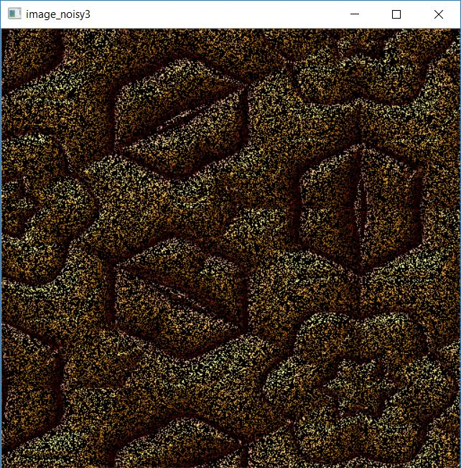
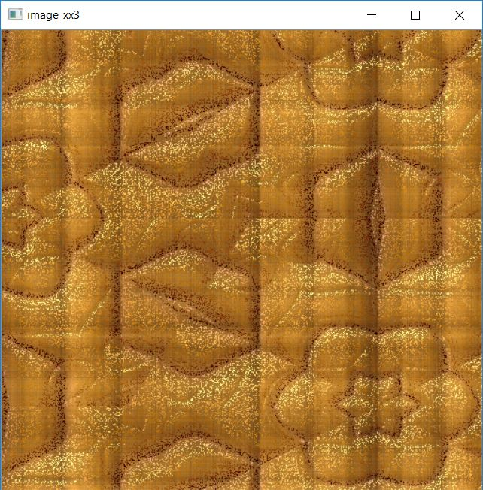
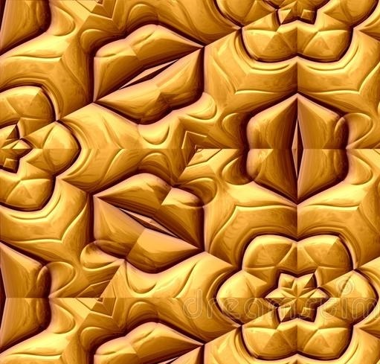
Results from silrtc
512 loops with 75% of pixels missing from the original image:

Slide 12
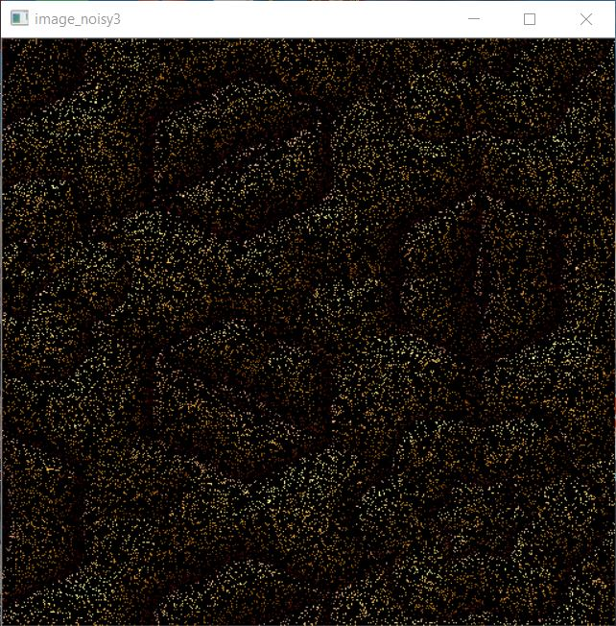
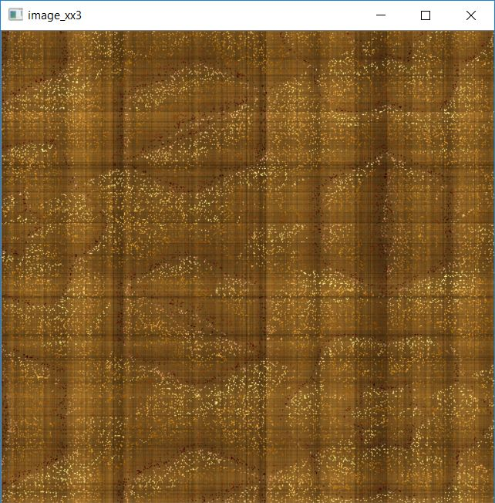
Results from silrtc
512 loops with 90% of pixels missing from the original image:

Slide 13
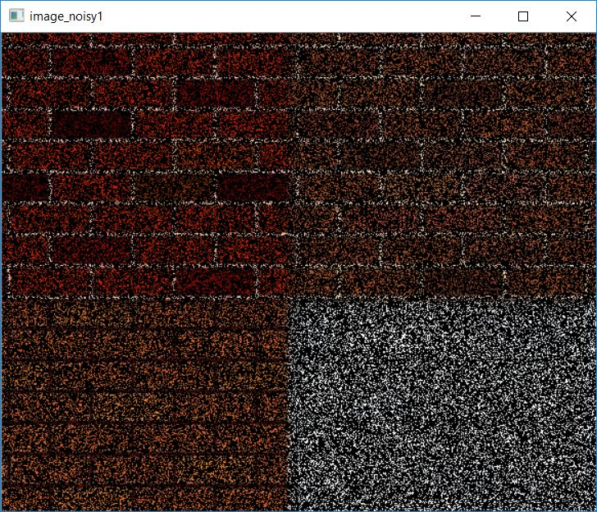
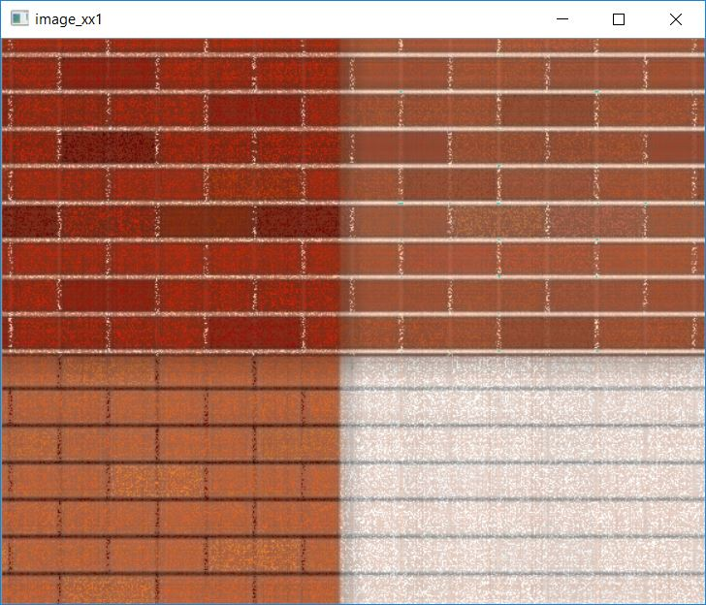
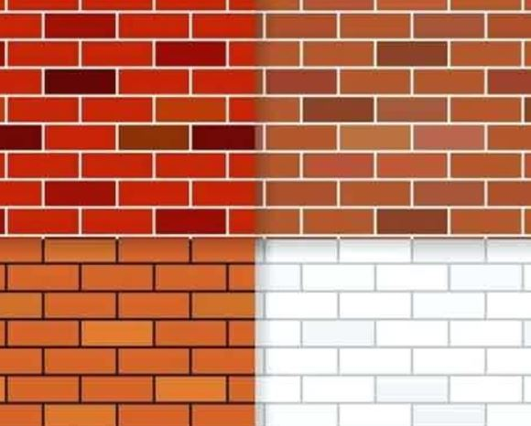
Results from silrtc
512 loops with 75% of pixels missing from the original image:

Slide 14
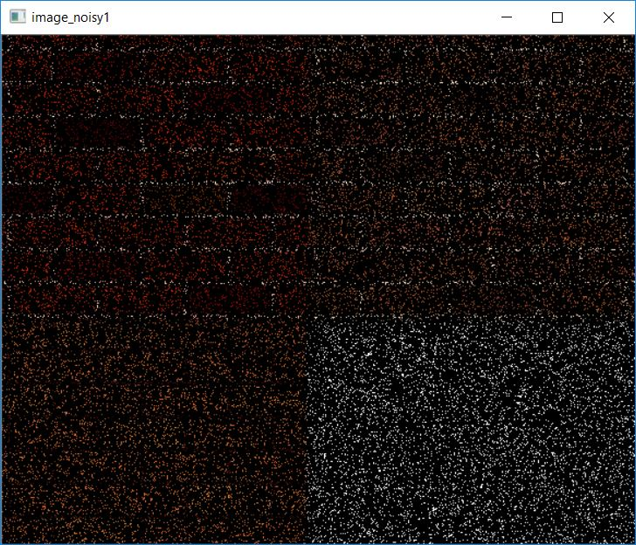
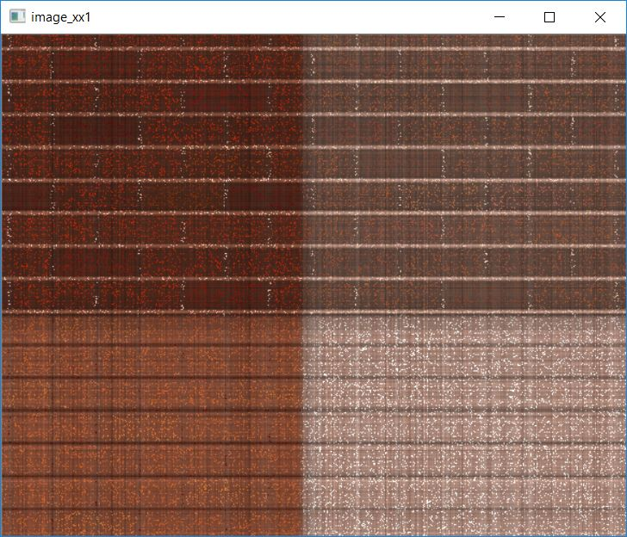
Results from silrtc
512 loops with 90% of pixels missing from the original image:

Slide 15
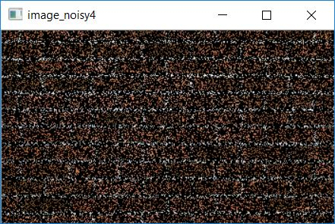
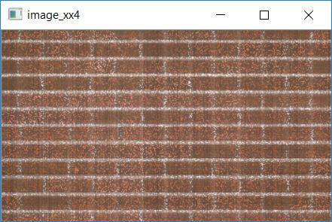
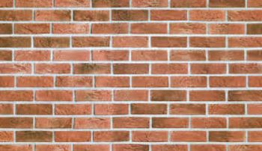
Results from silrtc
512 loops with 75% of pixels missing from the original image:

Slide 16
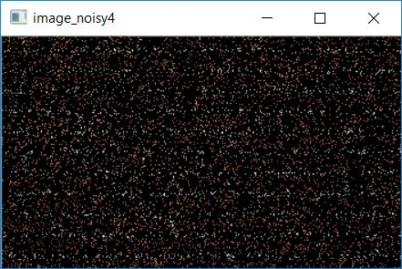
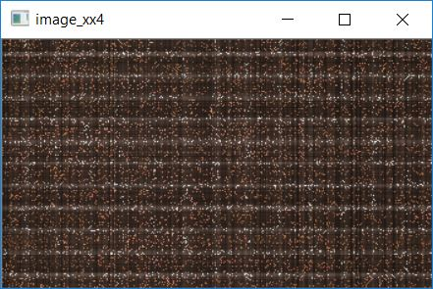
Results from silrtc
512 loops with 90% of pixels missing from the original image:

Slide 17
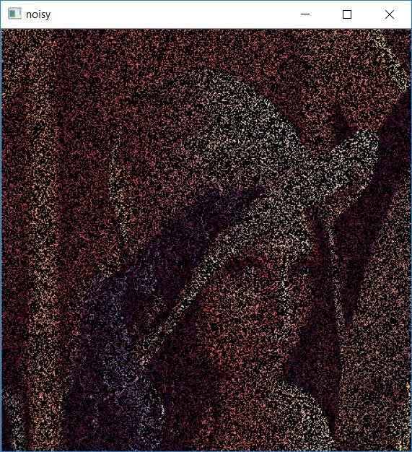
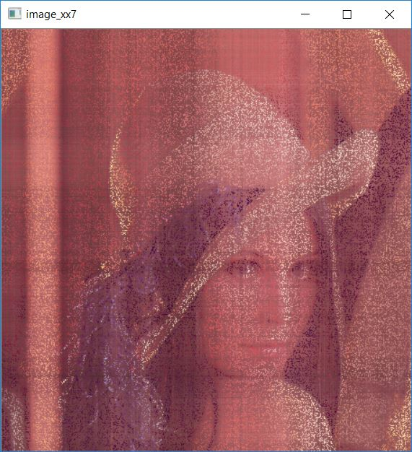
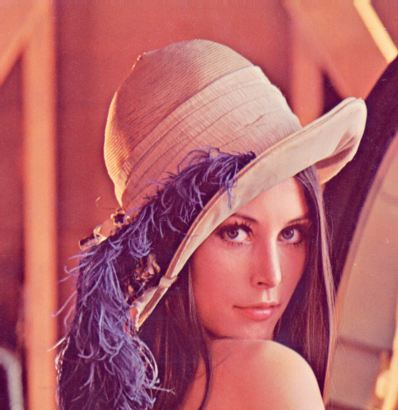
Results from silrtc
512 loops with 75% of pixels missing from the original image:

Slide 18
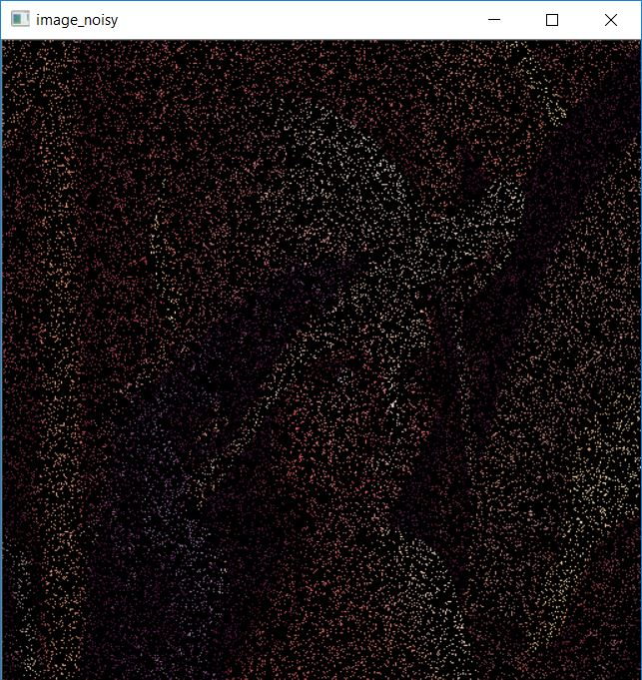
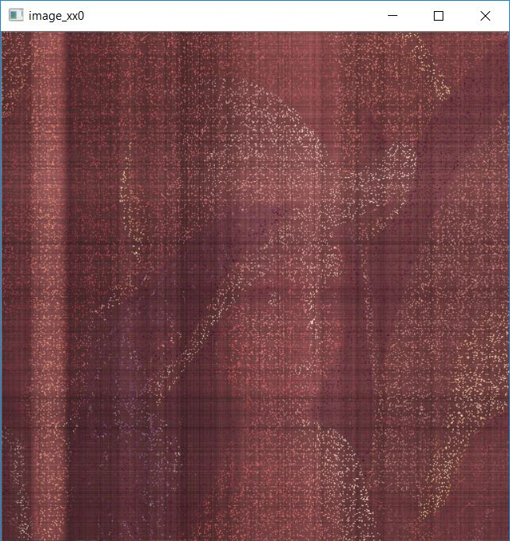
Results from silrtc
200 loops with 90% of pixels missing from the original image:

Slide 19

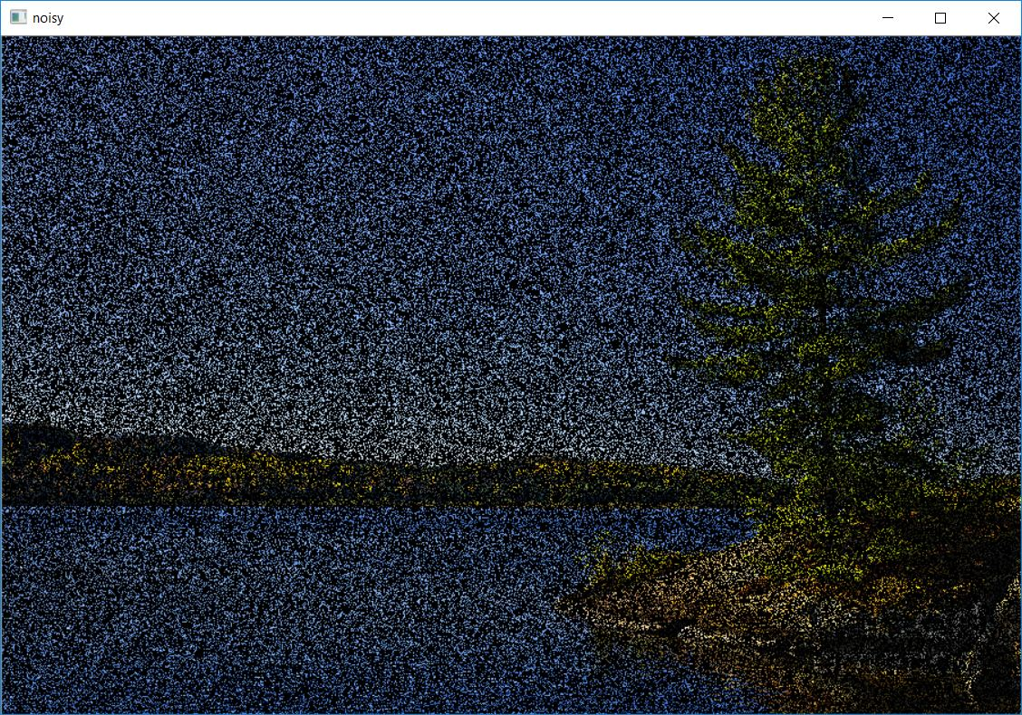
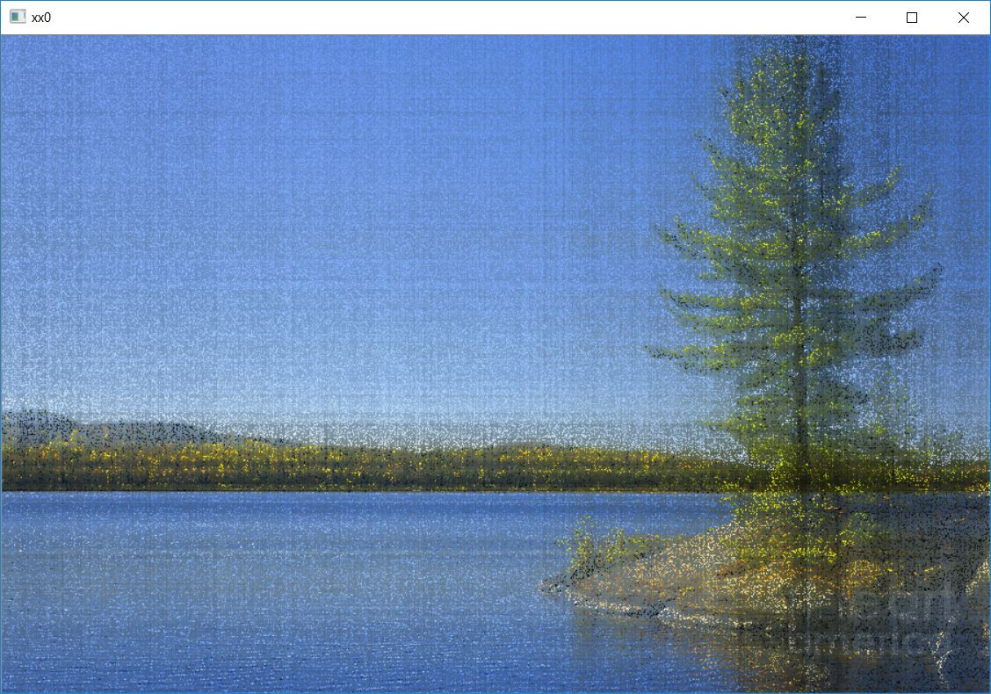
Results from silrtc
16 loops with 75% of pixels missing from the original image:

Slide 20
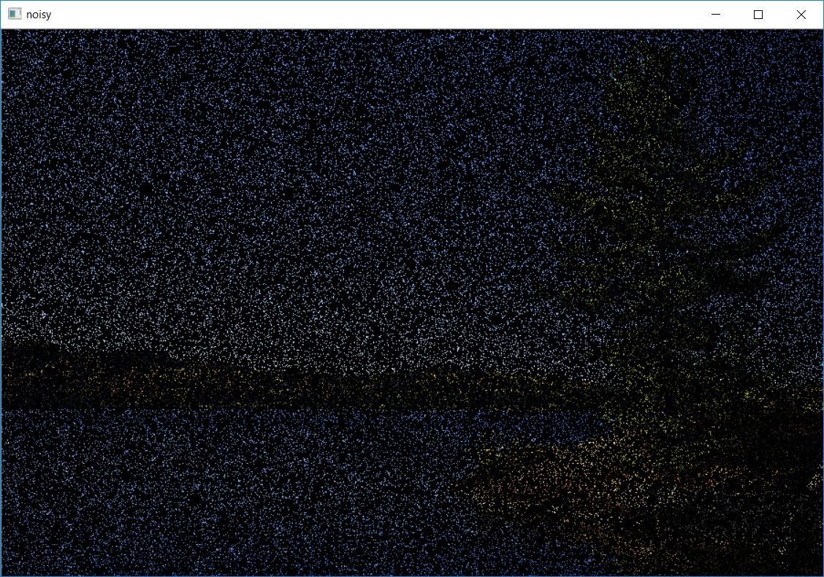
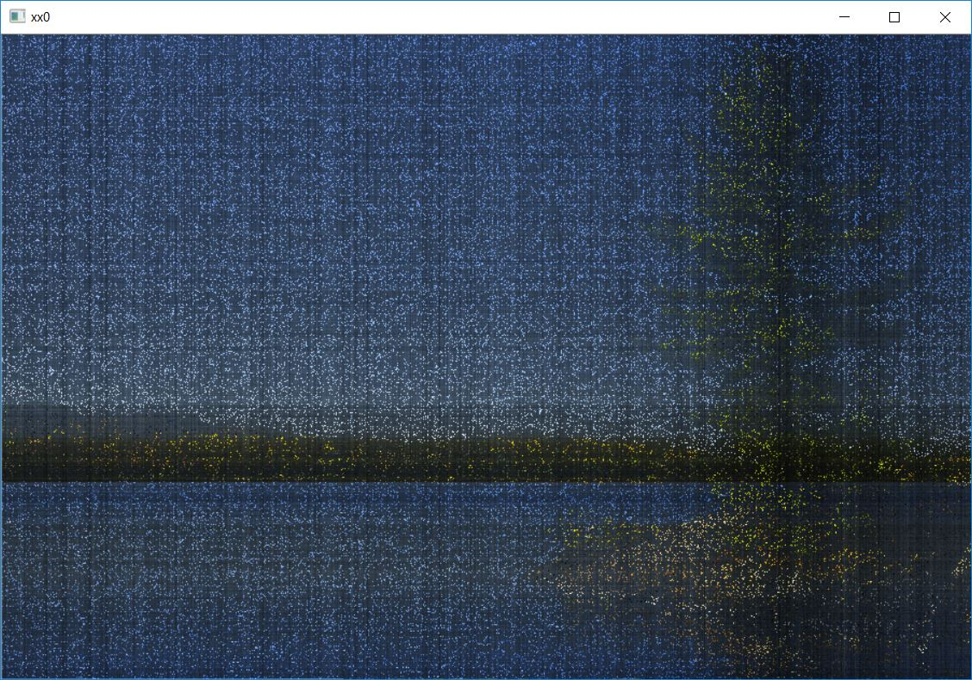
Results from silrtc
16 loops with 90% of pixels missing from the original image:

Slide 21

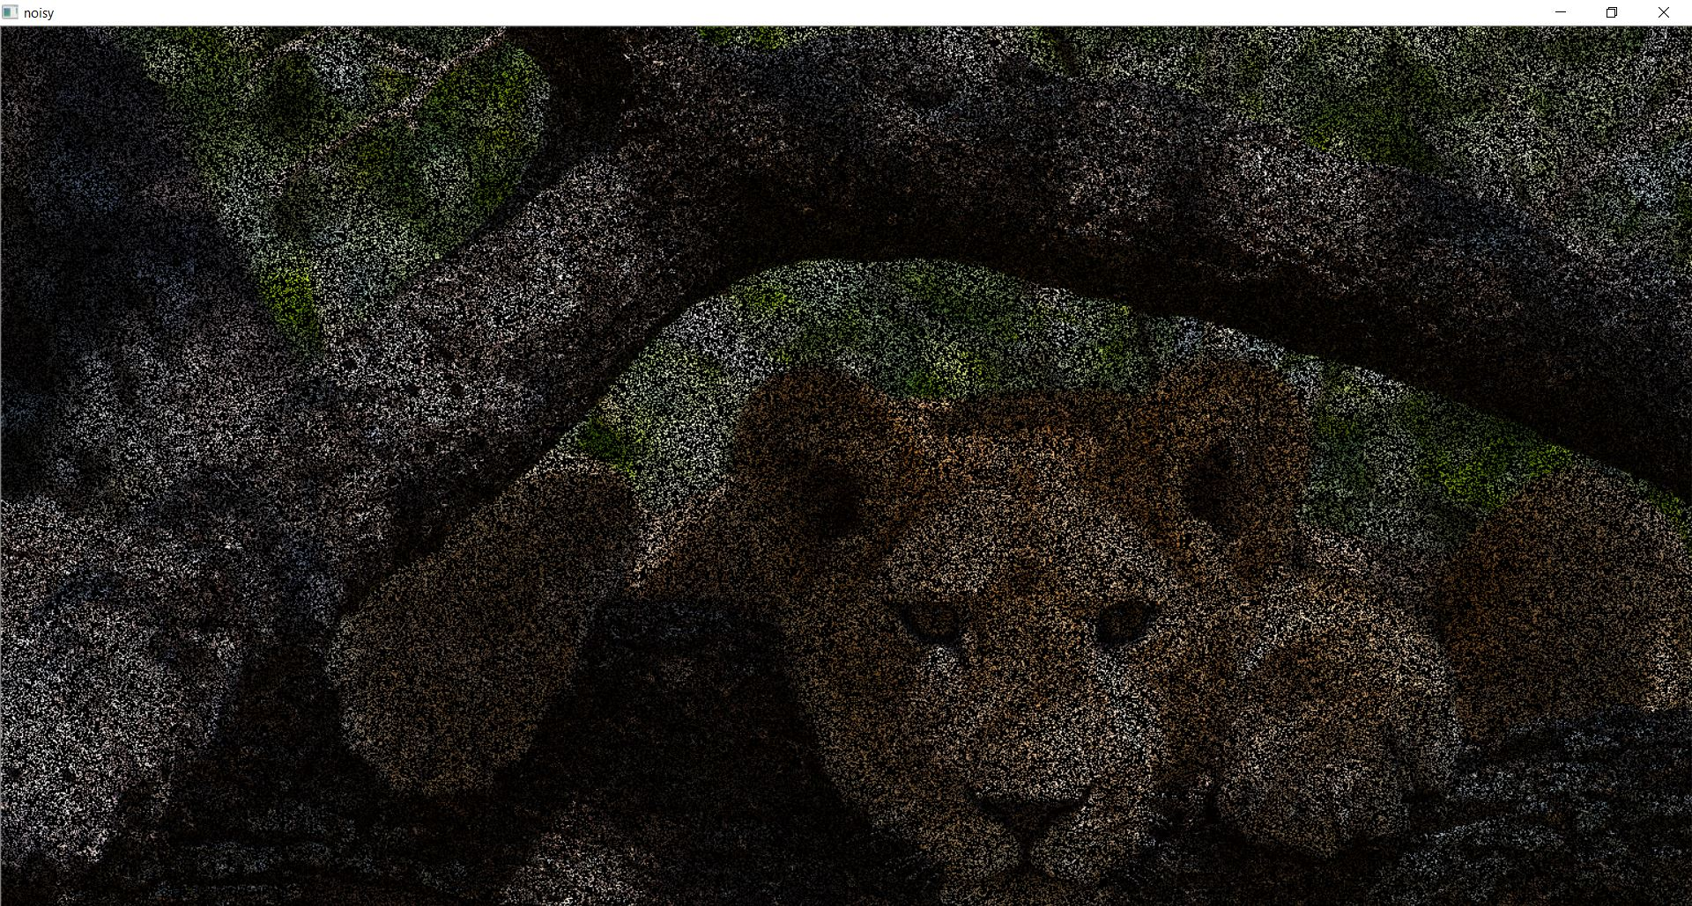
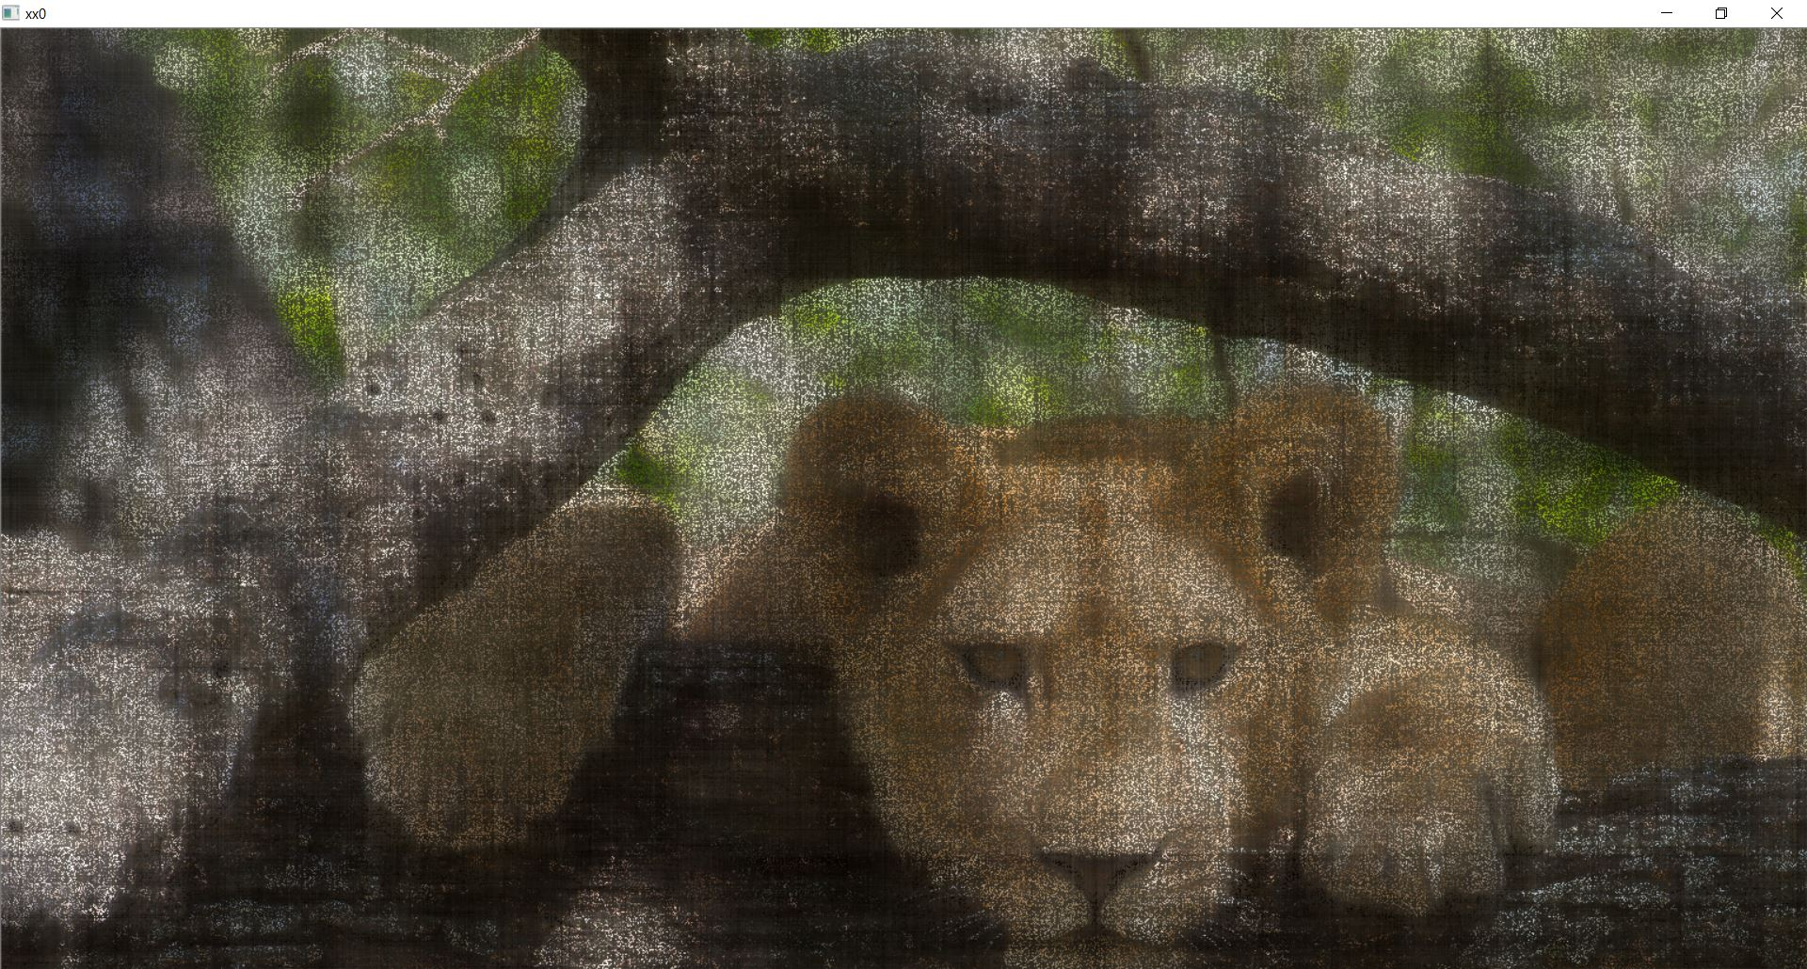
Results from silrtc
16 loops with 75% of pixels missing from the original image:

Slide 22
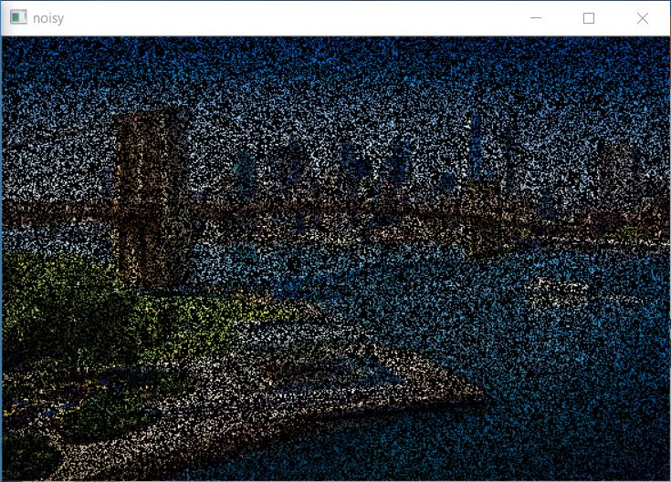
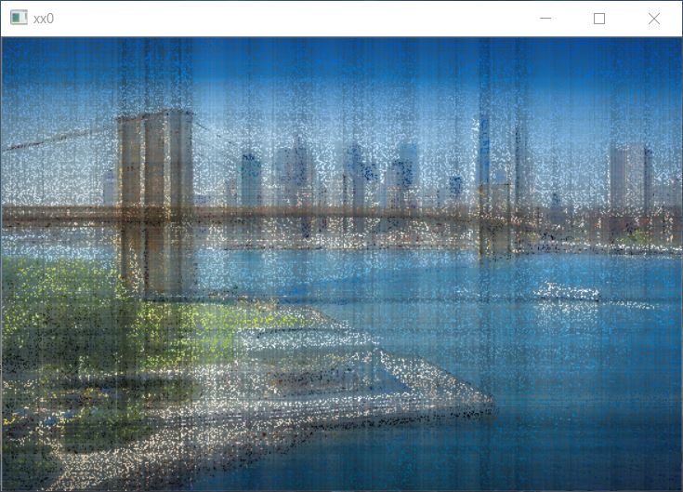

Results from silrtc
32 loops with 75% of pixels missing from the original image:

